Slide 1
Agenda
BIGDATA
Hadoop Overview
HDFS
MapReduce
Hadoop Ecosystem

Slide 2

Notes:
Binary ocean! Oh shit. How do I navigate business in this new sea of big data. Surely there’s a Hadoop vendor out there who can help me.
I’m not quite sure why the boat is also binary. But the dude isn’t binary. WHAT DOES IT ALL MEAN!?

Slide 4



Slide 5
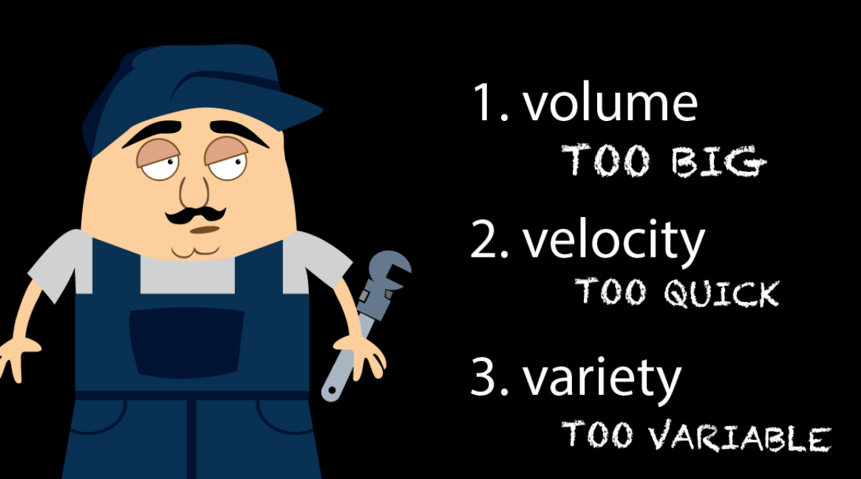
Today, Facebook ingests 500 terabytes of new data every day.
IBM claims 90% of today’s stored data was generated in just the last two years.
Clickstreams and ad impressions capture user behavior at millions of events per second
Big Data isn't just numbers, dates & Strings. Big Data is also geospatial data, audio and video, and unstructured text, and social media.
Traditional database systems were designed to address smaller volumes of structured data, fewer updates or a predictable, consistent data structure.
Real-time big data isn’t just a process for storing petabytes or Exabyte's of data in a data warehouse, It’s about the ability to make better decisions and take meaningful actions at the right time.

Slide 6
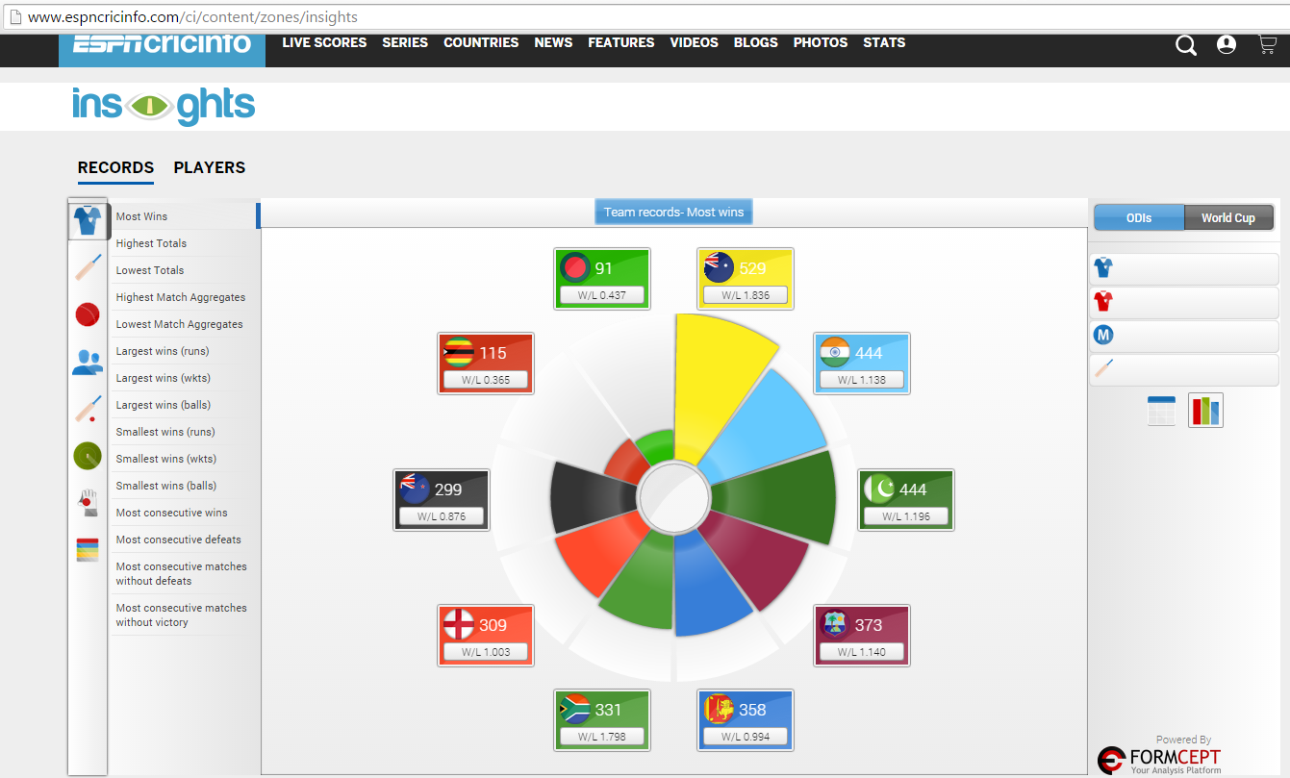
Tools that use Big Data Analytics for Cricket Predictions: Insights by ESPNCricInfo

Slide 7
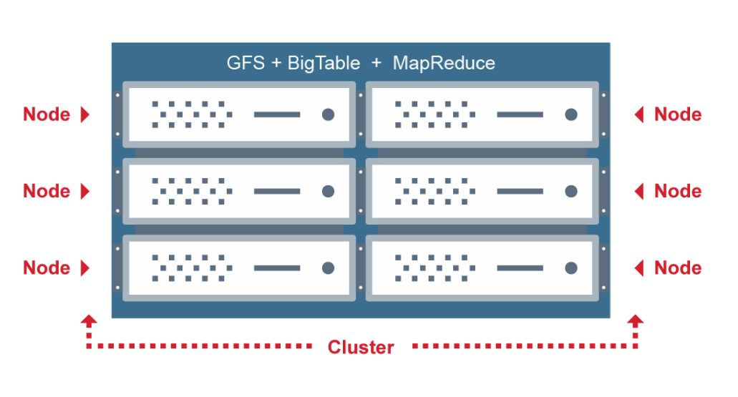
Google’s Solution

Slide 8


Slide 10

Hadoop
Open-source Apache project out of Yahoo! in 2006
Distributed fault-tolerant data storage and batch processing
Provides linear scalability on commodity hardware
Adopted by many:
Amazon, eBay, Facebook, IBM, Netflix, Twitter, Yahoo!,…. and many, many more

Slide 11
Why?
Bottom line:
Flexible
Scalable
Inexpensive
Great at
Reliable storage for multi-petabyte data sets
Batch queries and analytics
Complex hierarchical data structures with changing schemas, unstructured and structured data
Not so great at
Changes to files (can’t do it…)
Low-latency responses
Analyst usability
This is less of a concern now due to higher-level languages
Bytes!
No more ETL necessary
Store data now, process later
Structure on read
Built-in support for common data types and formats
Extendable

Slide 12
Versioning
Version 0.20.x, 0.21.x, 0.22.x, 1.x.x
Two main MR packages:
org.apache.hadoop.mapred (deprecated)
org.apache.hadoop.mapreduce (new hotness)
Version 2.x.x, alpha’d in May 2012
NameNode HA
YARN – Next Gen MapReduce

Slide 13
HDFS Overview
Hierarchical UNIX-like file system for data storage
sort of
Splitting of large files into blocks
Distribution and replication of blocks to nodes
Two key services
Master NameNode
Many DataNodes
Checkpoint Node (Secondary NameNode)
Notes:
Looks a lot like UNIX file system – contains files, folders, permissions, users, and groups
Isn’t actually stored that way –
Large data files are split into blocks and placed on DataNode services
NameNode is the name server for the file name to block mapping – it knows how the file is split and where the data is in the cluster
All read and write requests go through the namenode, but data is served from the DataNodes via HTTP
Namespace is stored in memory, transactions are logged on the local file system
Secondary NameNode or checkpoint node creates snapshots of the NameNode namespace for fault tolerance and faster restarts

Slide 14
How HDFS Works - Writes
Single master service for HDFS
Stores file to block to location mappings in the namespace
All transactions are logged to disk
Client contacts NameNode to write data
NameNode says write it to these nodes
Client sequentially
writes blocks to DataNode
Stores blocks on local disk
Sends frequent heartbeats to NameNode
Sends block reports to NameNode
Clients connect to DataNode for I/O
Notes:
Client contacts the namenode with a request to write some data
Namenode responds and says okay write it to these data nodes
Client connects to each data node and writes out four blocks, one per node

Slide 15
HDFS 2.0 Features
NameNode High-Availability (HA)
Two redundant NameNodes in active/passive configuration
Manual or automated failover
NameNode Federation
Multiple independent NameNodes using the same collection of DataNodes

Slide 16
Hadoop MapReduce 1.x
Moves the code to the data
JobTracker
Single point of failure for MapReduce
Master service to monitor jobs
TaskTracker
Multiple services to run tasks
Same physical machine as a DataNode
A job contains many tasks
A task contains one or more task attempts
Notes:
Job tracker takes submitted jobs from clients and determines the locations of the blocks that make up the input
One data block equals one task
Task attempts are distributed to TaskTrackers running in parallel with each DataNode, thus giving data locality for reading the data
Successful task attempts are good! Failed task attempts are given to another TaskTracker for processing
4 single failed task attempts equals one failed job

Slide 17
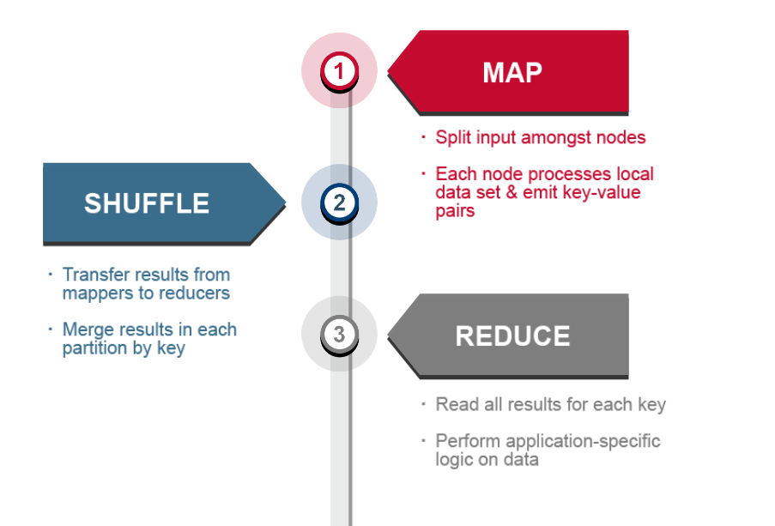
MAP REDUCE

Slide 18
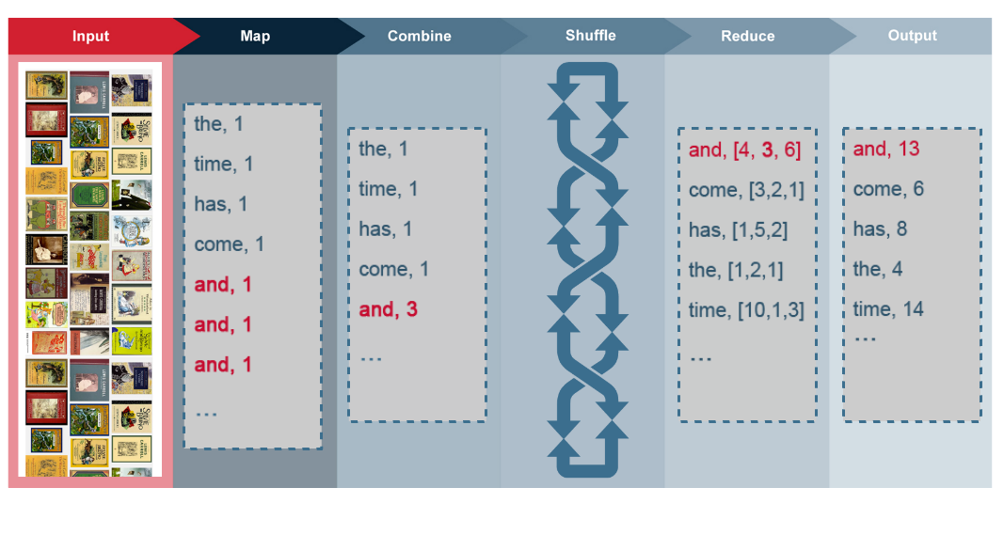
WORD-COUNT program

Slide 19
YARN
Abstract framework for distributed application development
Split functionality of JobTracker into two components
ResourceManager
ApplicationMaster
TaskTracker becomes NodeManager
Containers instead of map and reduce slots
Configurable amount of memory per NodeManager
MapReduce API has not changed
Rebuild required to upgrade from 1.x to 2.x
Application Master launches and monitors job via YARN
MapReduce History Server to store… history

Slide 20
Hadoop Ecosystem

Slide 21
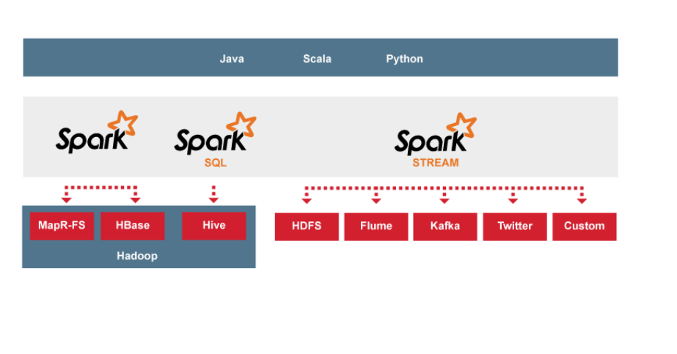
Spark

Slide 22
Higher Level APIs
Pig
Data-flow language – aptly named PigLatin -- to generate one or more MapReduce jobs against data stored locally or in HDFS
Hive
Data warehousing solution, allowing users to write SQL-like queries to generate a series of MapReduce jobs against data stored in HDFS
Moving Data
Sqoop
Moving data between RDBMS and HDFS
Say, migrating MySQL tables to HDFS
Flume
Streams event data from sources to sinks
Say, weblogs from multiple servers into HDFS

Slide 23
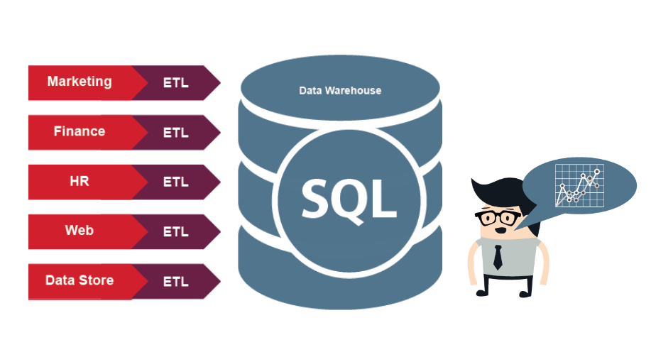
Trail

Slide 24
Pick the right tool for the right job

Slide 25
Acknowledgements
Apache Hadoop, the Hadoop elephant logo, HDFS, Drill, Flume, HBase, Hive, Mahout, Oozie, Pig, Sqoop, YARN, and ZooKeeper are trademarks of the Apache Software Foundation
EspnCricInfo

Slide 26
Thank you

